Slide 1

Multiple Linear Regression

Slide 2
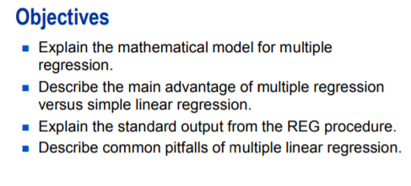
Multiple Linear Regression

Slide 3
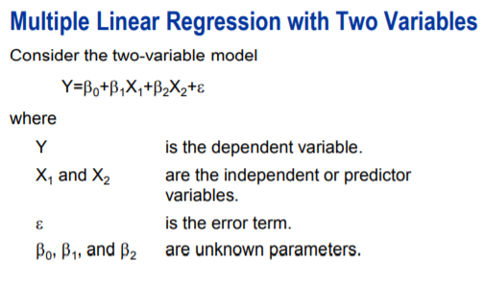
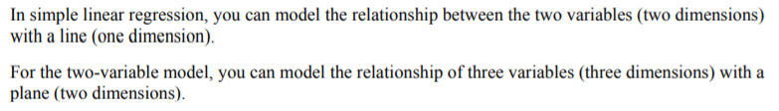
Multiple Linear Regression

Slide 4
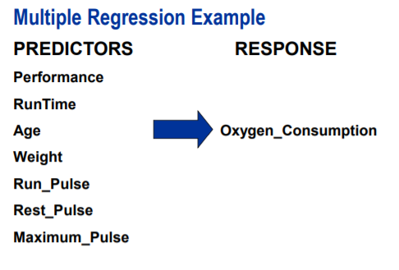
Multiple Linear Regression

Slide 5
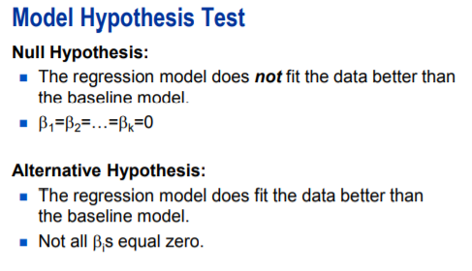
Multiple Linear Regression

Slide 6
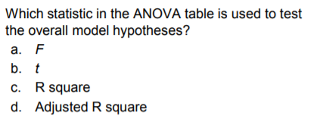
Multiple Linear Regression

Slide 7
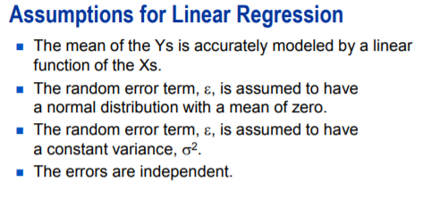
Multiple Linear Regression

Slide 8
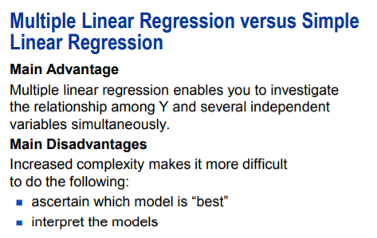
Multiple Linear Regression
The advantage of performing Multiple Linear Regression over a series of Simple linear regression models outweighs the disadvantages. In practice, many responses depend on multiple factor that might interact some way.

Slide 9
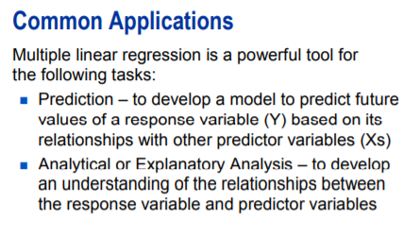
Multiple Linear Regression
Mayer suggested four applications of regression:
Prediction, Variable Screening, Model Specifications and Parameter Estimation.

Slide 10
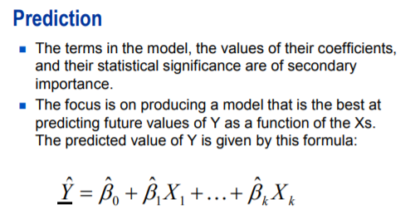
Multiple Linear Regression

Slide 11
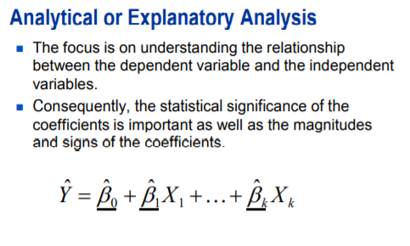
Multiple Linear Regression

Slide 12
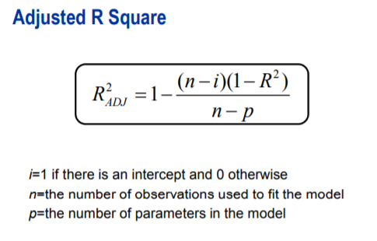
Multiple Linear Regression
The R square always increases or stays the same as you include more terms in the model. Therefore, choosing the best model is not as simple as just making the R square as large as possible.
Adjusted R square is a measure similar to R square, but it takes into account the number of terms in the model. It can be thought of a penalized version of R square with penalty increasing with each parameter added to the model.

Slide 13

DEMO

Slide 14
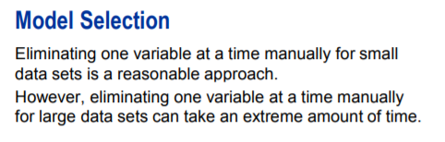
Multiple Linear Regression
A process for selecting models might be to start with all variables in the fitness dataset and eliminate the least significant terms based on p-values.
For a small dataset, a final model can be developed in a reasonable amount of time. If you start with large model, however, eliminating one variable at a time can take extreme amount of time. You would have to continue this process until p-values lower than some thresholds say, 0.05 remain.

Slide 15
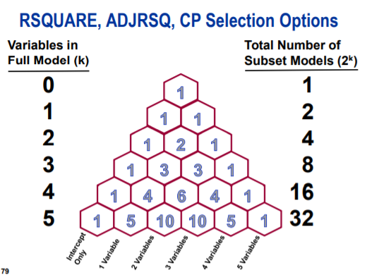

Multiple Linear Regression
In fitness dataset, there are seven possible predictors. Therefore, there are possible regression models. There are seven possible one-variable models, 21 possible two-variable models, 35 possible three-variable models.
If there were 20 possible predictors, there would be more than 100,000 models.

Slide 16
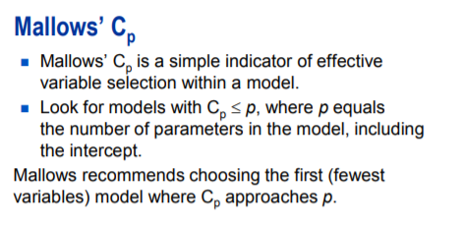
Multiple Linear Regression
Cp = p + (MSEp – MSE full) (n-p) / MSE full
Where,
MSEp is Mean Square Error for the model with p parameters
MSE full is Mean Square Error for the full model
N is sample size
P is the number of parameters including the intercept.

Slide 17
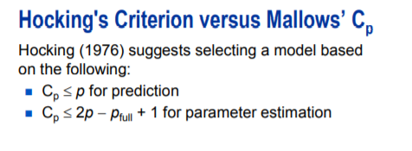
Multiple Linear Regression
Hocking suggested the use of Cp statistic but with alternative criteria, depends on purpose of the study.

Slide 18
DEMO

Slide 19
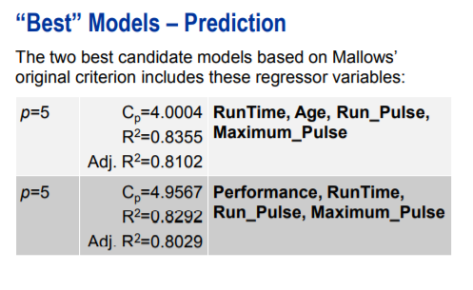
Multiple Linear Regression

Slide 20
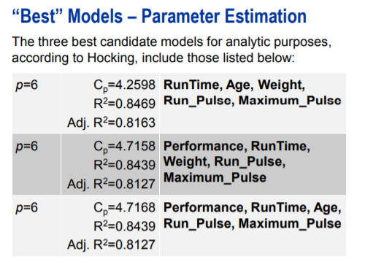
Multiple Linear Regression

Slide 21
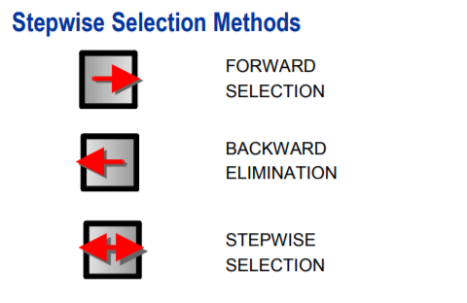
Multiple Linear Regression

Slide 22
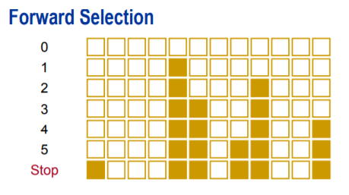
Multiple Linear Regression
Forward selection start with an empty model. The method computes an F statistics for each predictor variable not in the model and examines the largest of these statistics. If it is significant at selected level of significance, the corresponding variable will be added to the model. The process is repeated until none of the remaining variables meets the specified level for entry. Once the variable is added to the model, it will never be removed in any of the subsequent steps.

Slide 23
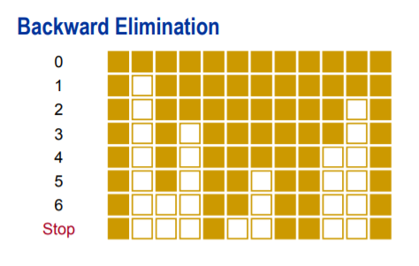
Multiple Linear Regression
Backward elimination starts off with the full model. Results of the F test for individual parameter estimates are examined and the least significant variable that falls above the specified significant level is removed. After the variable is removed from the model, it remains excluded.

Slide 24
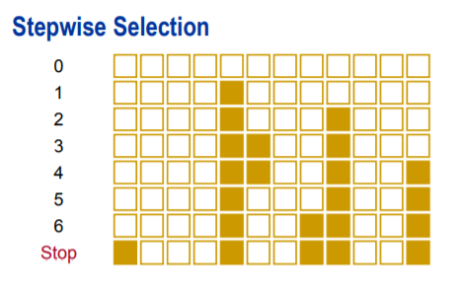
Multiple Linear Regression
Stepwise selection is similar to forward selection in that it starts with empty model and incrementally build a model one variable at a time.
However, the method differs from forward selection method in that variables already in the model do not necessarily remain.
The backward component of the method removes the variables from the model that do not meet the significance criteria.
The stepwise selection process terminates if no further variables can be added to the model or the variables entered into the model is the only variable removed in the subsequent backward elimination.

Slide 25
DEMO

Slide 26
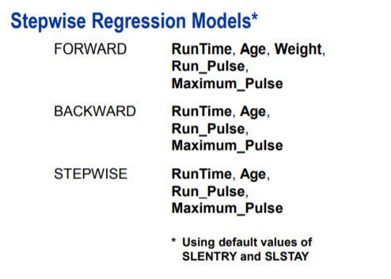
Multiple Linear Regression

Slide 27
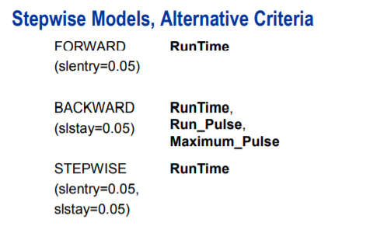
Multiple Linear Regression

Slide 28
Q&A

